Slide 1
Open Pseudonymiser Project
Julia Hippisley-Cox, 2011
www.openpseudonymiser.org

Slide 2
Open pseudonymiser approach
Need approach which doesn’t extract identifiable data but still allows linkage
Legal ethical and NIGB approvals
Secure, Scalable
Reliable, Affordable
Generates ID which are Unique to project
Can be used by any set of organisations wishing to share data
Pseudoymisation applied as close as possible to identifiable data ie within clinical systems

Slide 3
Pseudonymisation: method
Scrambles NHS number BEFORE extraction from clinical system
Takes NHS number + project specific encrypted ‘salt code’
One way hashing algorithm (SHA2-256) – no collisions and US standard from 2010
Applied twice - before leaving clinical system & on receipt by next organisation
Apply identical software to second dataset
Allows two pseudonymised datasets to be linked
Cant be reversed engineered

Slide 4
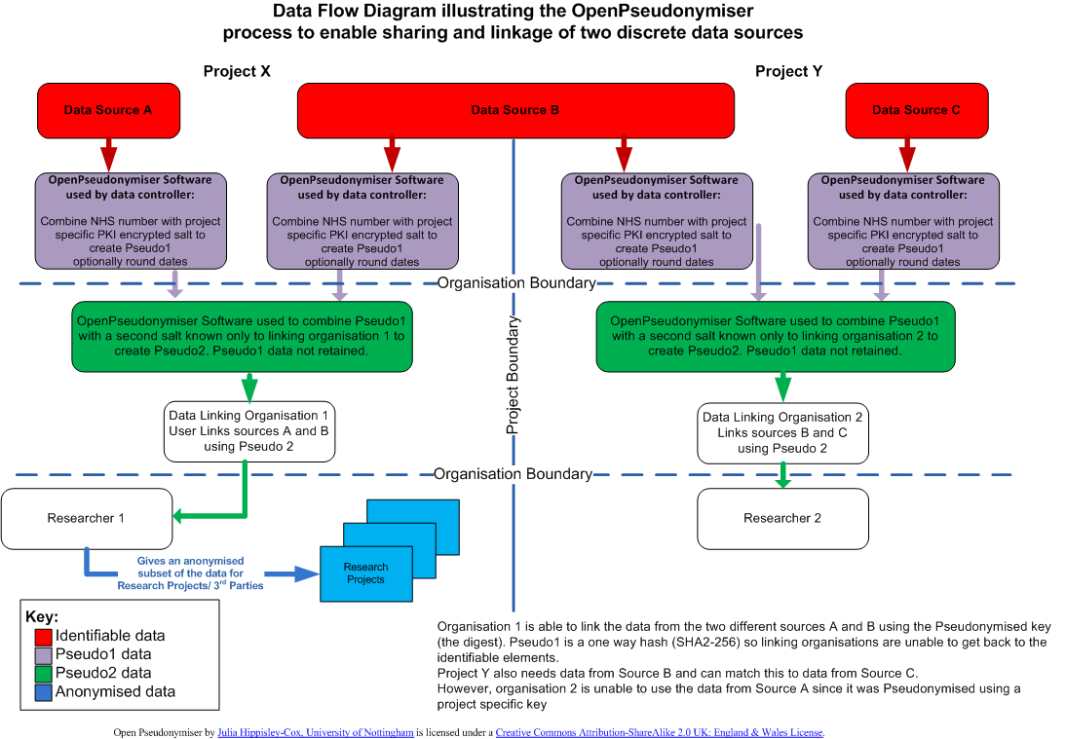

Slide 5
Wed tool to create encrypted salt: proof of concept
Web site private key used to encrypt user defined project specific salt
Encrypted salt distributed to relevant data supplier with identifiable data
Public key in supplier’s software to decrypt salt at run time and concatenate to NHS number (or equivalent)
Hash then applied
Resulting ID then unique to patient within project

Slide 6
Openpseudonymiser.org
Website for evaluation and testing with
Desktop application
DLL for integration
Test data
Documentation
Utility to generate encrypted salt codes
Source code GNU GPL
(note: currently undertaking freedom to operate checks)

Slide 7
Key points
Pseudonymisation at source
Instead of extracting identifiers and storing lookup tables/keys centrally, then technology to generate key is stored within the clinical systems
Use of project specific encrypted salted hash ensures secure sets of ID unique to project
Full control of data controller
Can work in addition to existing approaches
Open source technology so transparent & free

