Slide 1
NHS e-Lab
Nottingham, September 2010
John Ainsworth (john.ainsworth@manchester.ac.uk)

Slide 2
Our Approach
Enforce information governance through technology wherever possible
Designed for minimum data release
Only release items that user “Needs to know”
NHS is in control of data at all times; NHS can choose what to make available through the e-Lab
Data is stored in a repository hosted on a server inside the NHS Trust

Slide 3
Information Governance
Technical safeguards
  Access Control based on privileges
  Audit trails & monitoring
  Anonymisation and Inference control
Operational
  Users sign up to terms and conditions of use; bound by employment contracts
  Auditing of users
  Standard Operating Procedures
Governance Board + NRES Research Database Approval

Slide 4
NHS Trust
EHR
E-Lab
Pseudonymised
Data
Repository
Governance
Users

Slide 5
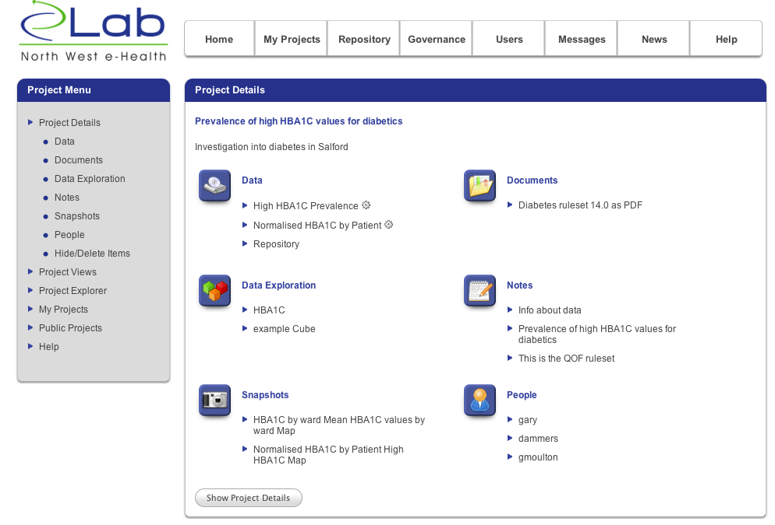

Slide 6
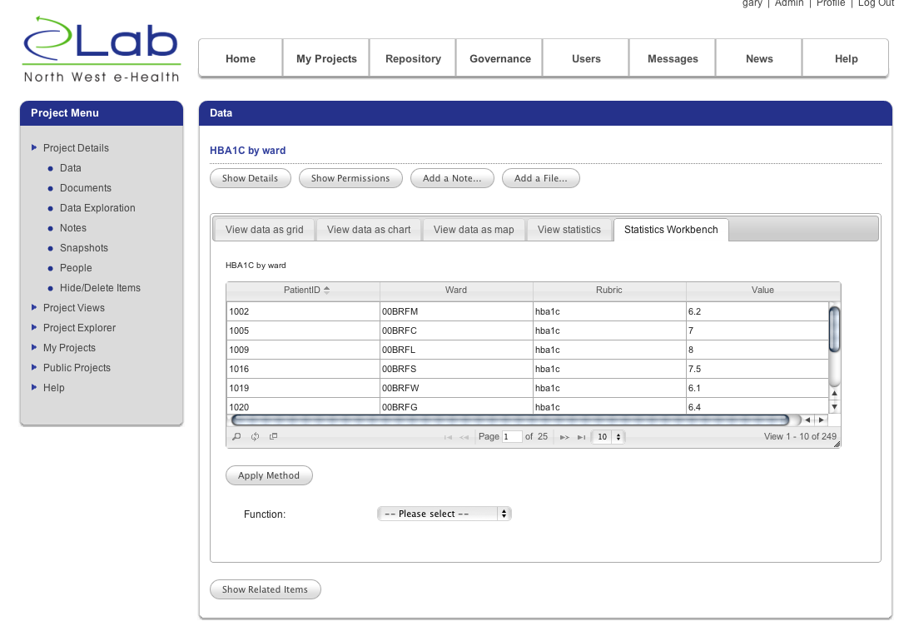

Slide 7
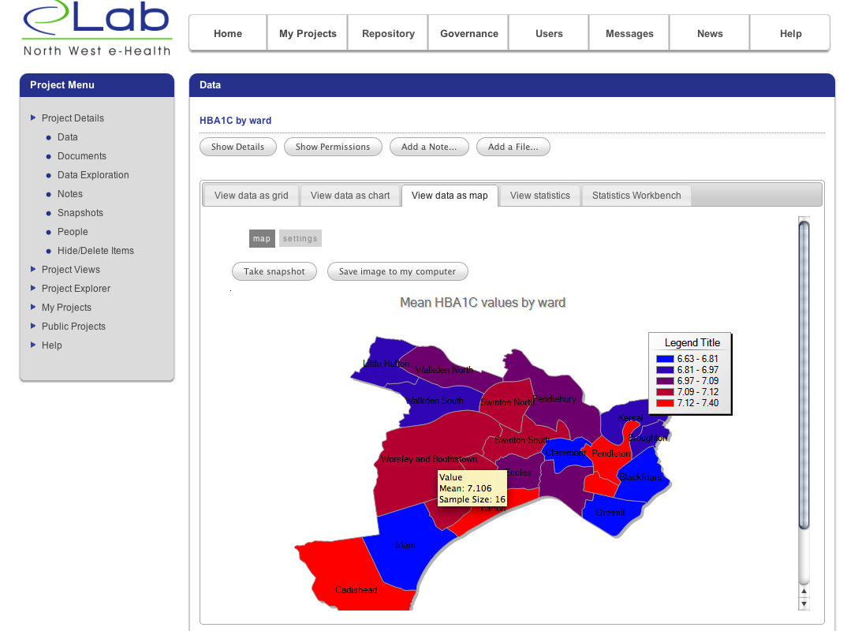

Slide 8
2. Pseudonymisation
Clinical
Data
Trust Systems
Trust e-Lab
Clinical
Data
Integrated
EHR
Pseudonymised
Data
Repository
Non-clinical
Data
Non-clinical
Data
1. Integration of primary and secondary care records

Slide 9
Trust e-Lab
Psuedonymised
Repository
3. Perform Data
Query
4. Anonymisation and inference control
2. Access control module authorizes request
User Data
Store
5. Storage
1 .User logs on and submits query
Access Control
e-Lab Tools
6. Data analysis and visualization

Slide 10
Data Extraction
Copies data from one database to another
Performs transformations on data fields e.g.
  Postcode => LLSOA
  Postcode => Area
  Date = > year
  Date => year and quartile
  * => SHA-1 + user defined salt
  * => RSA public-private key encryption
  * => random 32-bit integer
Plug-in architecture for transformers

Slide 11
Pseudonymisation

Slide 12
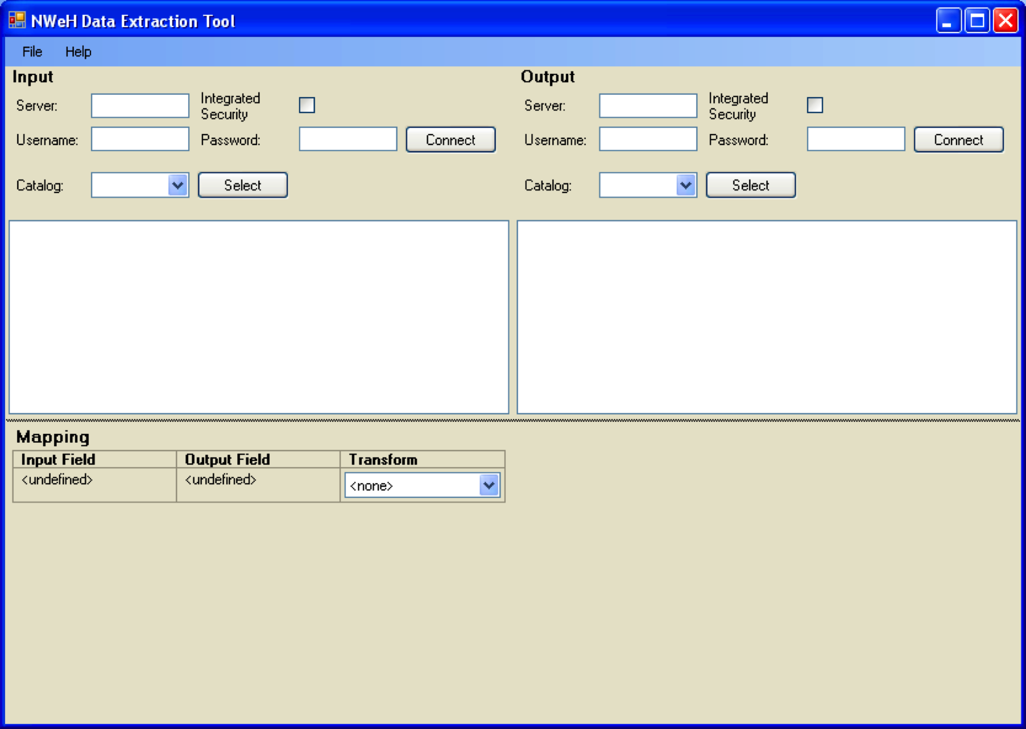
Data Extraction

Slide 13
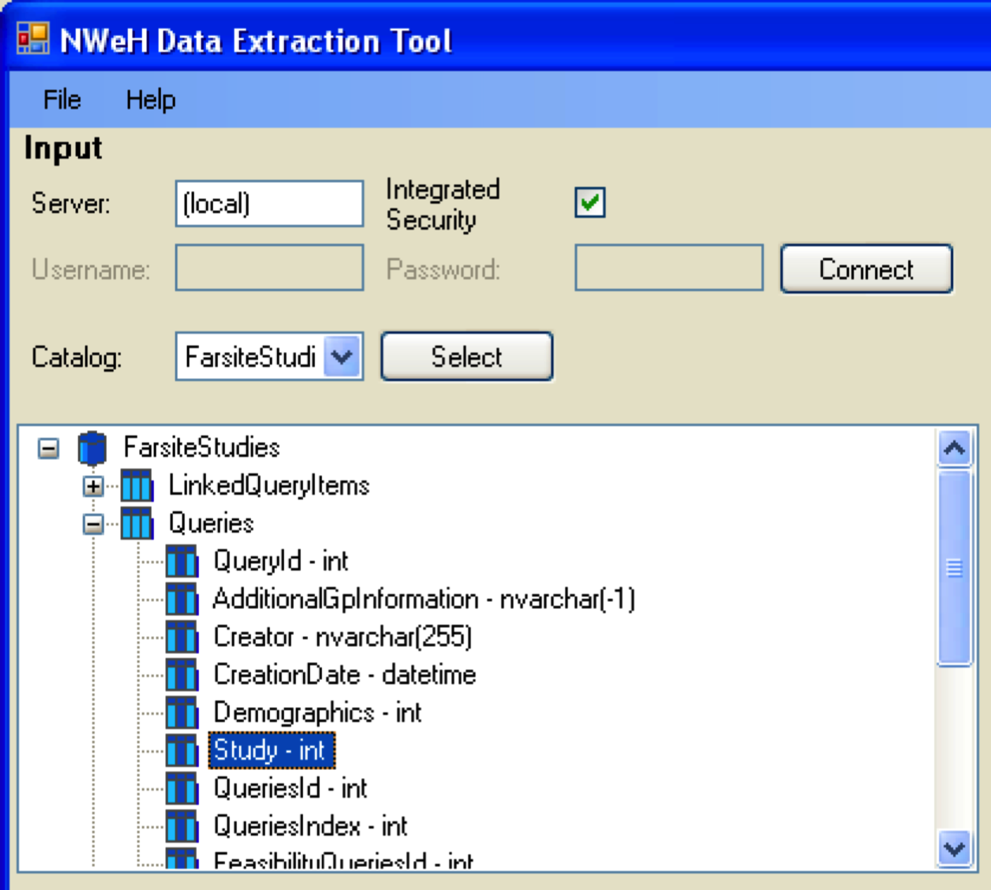
Data Extraction

Slide 14
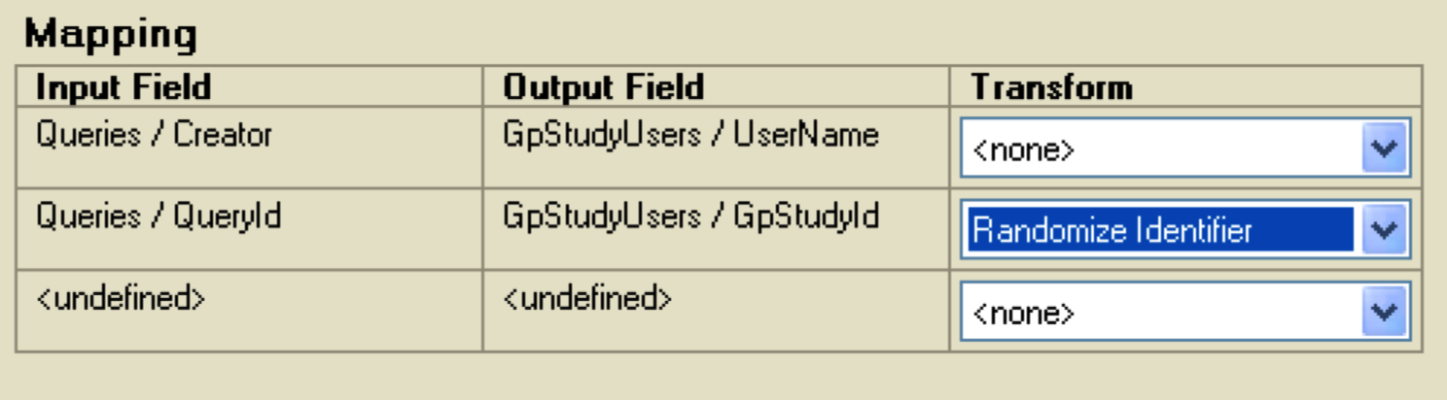
Data Extraction

