Slide 1
Open Pseudonymisation workshop
Nottingham
22nd Sept 2011

Slide 2
JHC roles
Research chair at UoN –epidemiology, risk prediction and drug safety
Developed and run the not-for-profit QResearch database with EMIS
Medical Director Clinrisk Ltd (medical software)
Inner city GP
Member of the ECC NIGB

Slide 3
Overall aim
Open common technical specification for pseudonymisation
allows individual record linkage BETWEEN organisations
WITHOUT disclosure strong identifiers
Voluntary specification
May become standard over time if adopted

Slide 4
Key factors for successful IT projects
Agreed Purpose
Clear requirements
Practical affordable solution
Right time
Right People - skills, experience etc

Slide 5
Terms of engagement
Intention is for output from workshop to be
published
open
freely available for anyone to use
Seek to avoid infringing any existing IP

Slide 6
Key objectives for safe data sharing
Maximise public benefit
Patient and their data
Minimise risk
Privacy
Maintain public trust

Slide 7
Three main options for data access
Maximise public benefit
Pseudo
nymisation
consent
Patient and their data
Minimise risk
Privacy
Maintain public trust
s251

Slide 8
Terminology (DH de-identification draft standard, v1.1 2011)
Identifiable information
Includes person identifier that will ordinarily and simply identify a person (name, address, dob, postcode, NHS number)
De-identified information
Information that was identifiable but has had personal identifiers stripped out to create dataset where identifiers not present

Slide 9
Terminology (DH de-identification draft standard, v1.1 2011)
Pseudoymised information
De-identified where a coded reference used to associate information with a unique individual without enabling that individual to be identified
Either reversible or reversible
Effectively anonymised information
No reasonable chance that recipient could infer identities.
Not considered personal data or confidential patient information

Slide 10
Assumptions for today
Legitimate use of data
legitimate purpose
legitimate applicant or organisation
Ethics and governance approval in place
Appropriate data sharing agreements

Slide 11
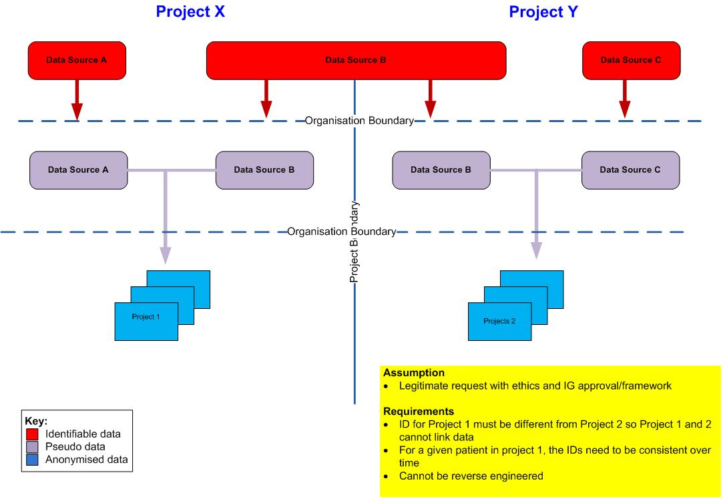
The task for today

Slide 12
High level requirements of solution
Legal & Ethical
Secure
Reliable
Scalable
Confidence profession & public
Different unique IDs for each project
Affordable
Capable of implementation across the NHS

Slide 13
Out of scope for today
Who provides services?
Where its located?
How its funded?
How its implemented?
Broader issues of IG such as
De-identification
Methods to assess risk of re-identification
Policy issues
Definition safe haven, honest brokers etc

Slide 14
Open discussion
Introduce ourselves
What do we want to get from the meeting
How do we need to use pseudonymisation in our organisation

